Slide 1



Slide 2

Foxboro Coaches:
This presentation is designed to bring some clarity to the process of organizing and preparing your training sessions. The insights shared here are an attempt to enable all coaches to feel comfortable in setting the right tone and to possess a vision of what the game entails. There are so many variables to coaching and this is just scratching the surface of this magnificent game. Hope this inspires you to dive deeper into both the process and the tools needed towards the development of our players.
Brian Borde
Director of Coaching and Player Development

Slide 3
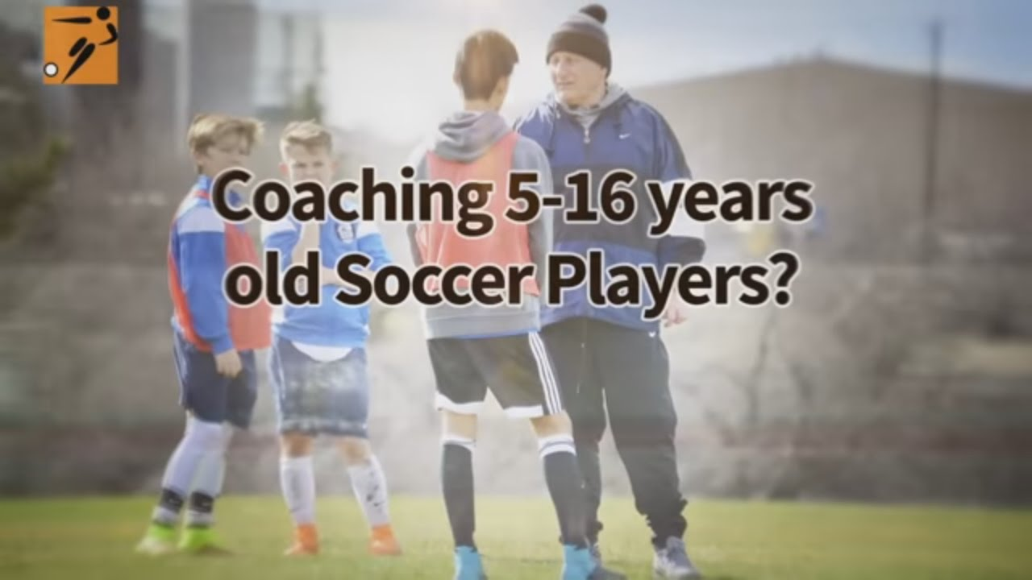

Slide 4

What do you want to teach them?

Slide 5
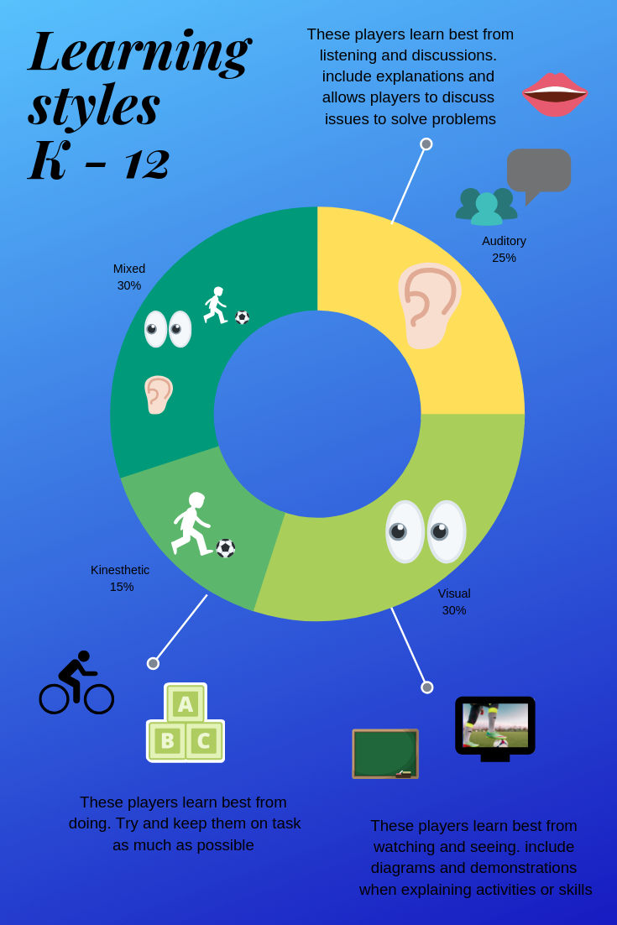
Understanding how they learn….age appropriate.

Slide 6
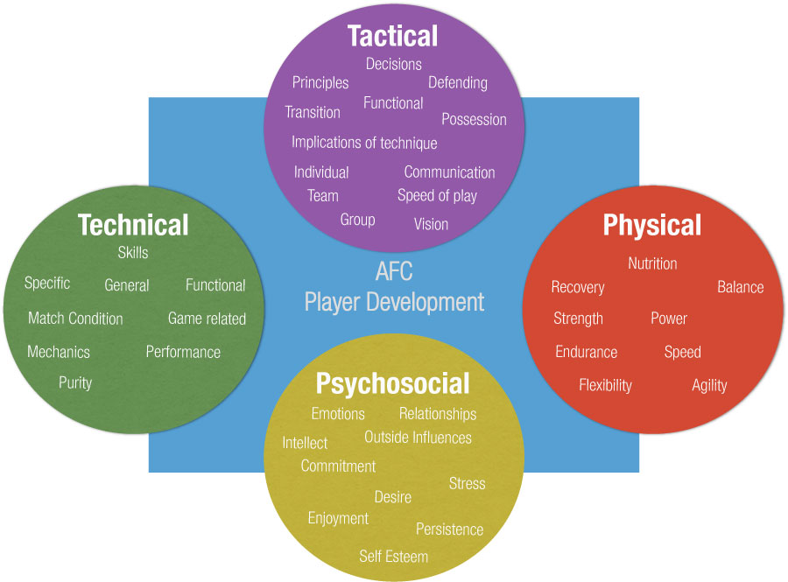
The 4 Pillars of the Game
Technical
Tactical
Physical
Psychological

Slide 7
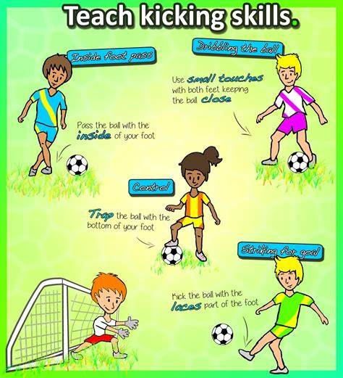
What do you want them to know and be able to do?

Slide 8
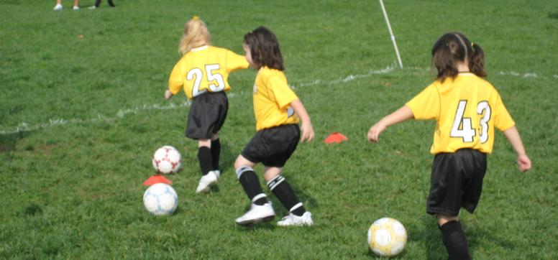
Is it technical, tactical, or functional?

Slide 9
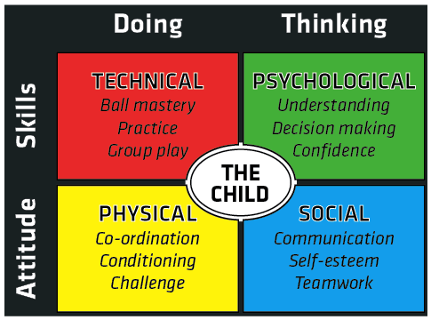

Slide 10
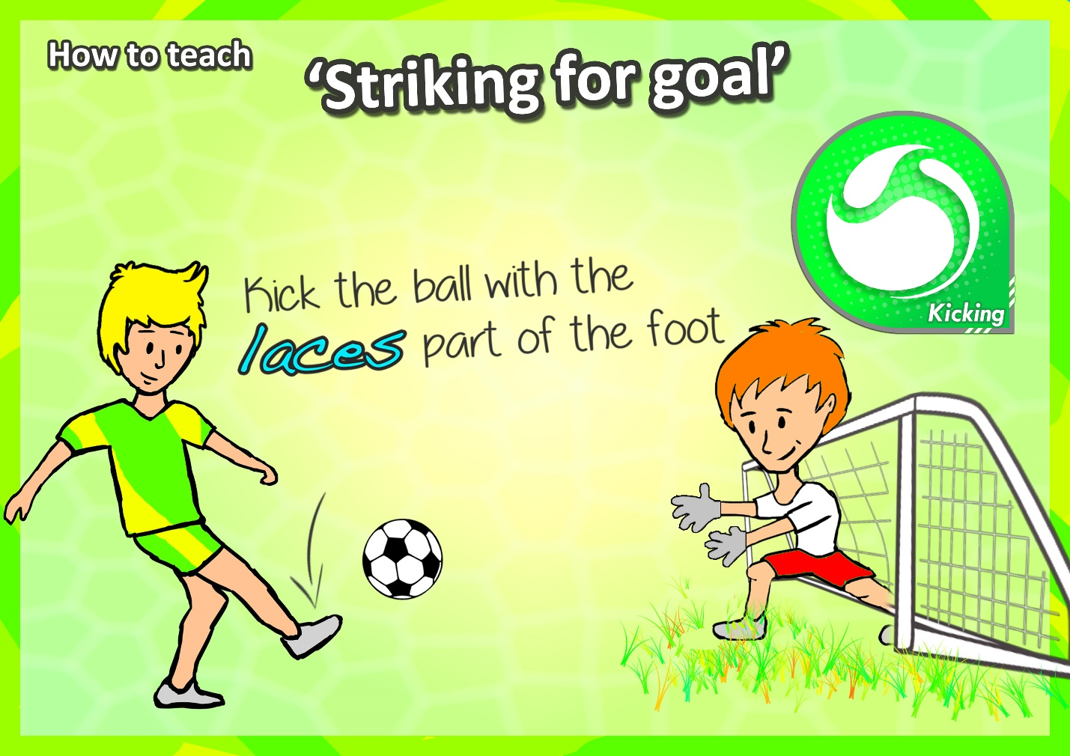

Slide 11
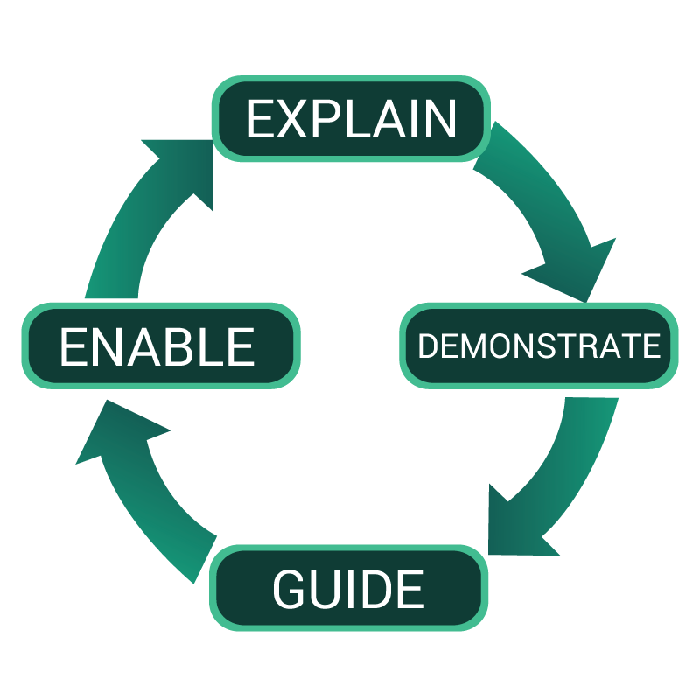
METHODOLOGY OF COACHING SKILLS
INTRODUCE
EXPLAIN
DEMONSTRATE
ORGANIZE INTO GROUPS
PRACTICE
CRITICIZE/CRITIQUE

Slide 12
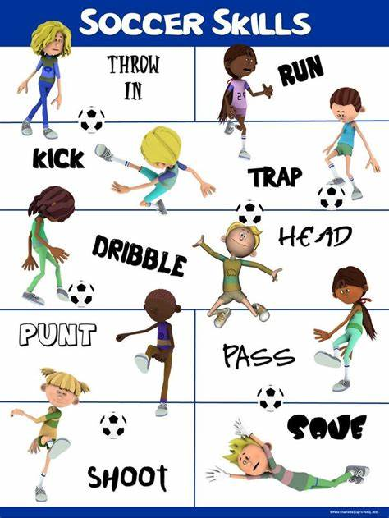
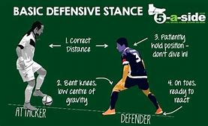
Teaching Technique….How to?
Fundamental (technique)
Match Related (some pressure)
Match Condition (game)

Slide 13
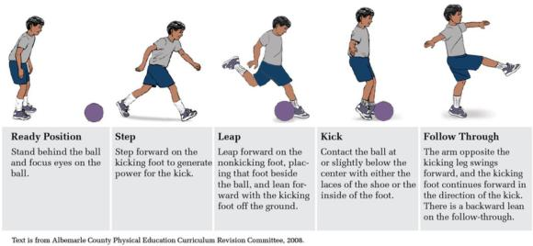
The technique…can we break it down?

Slide 14
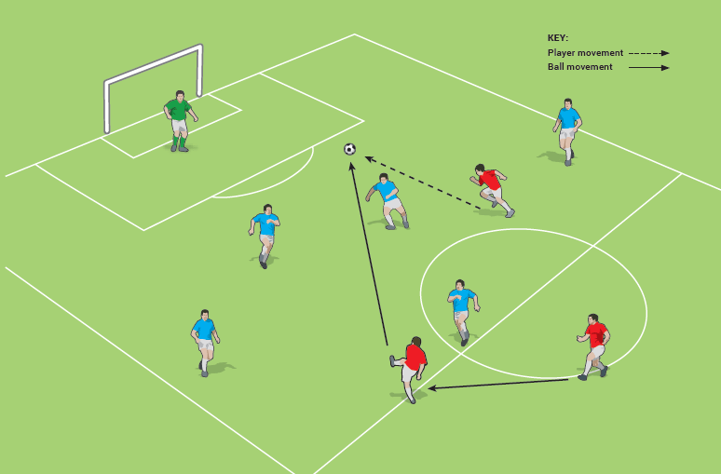
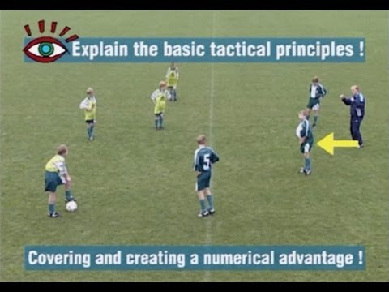
Teaching Tactics….Where and When to?
Tactic (eg.2v1 combination) to one goal
Tactic to both goals (transition)
Game

Slide 15
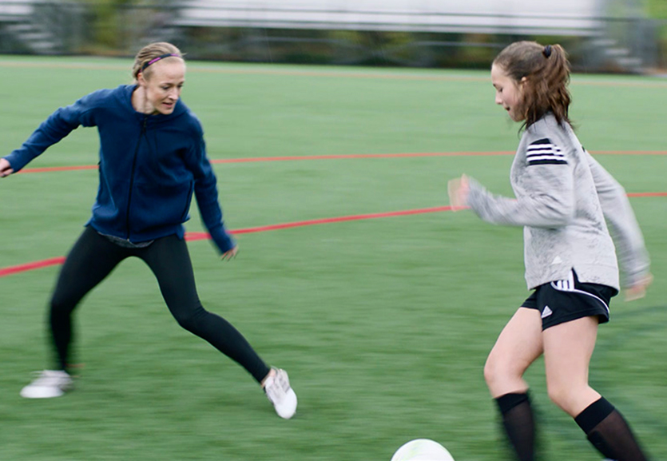
Are they successful at the technique?

Slide 16
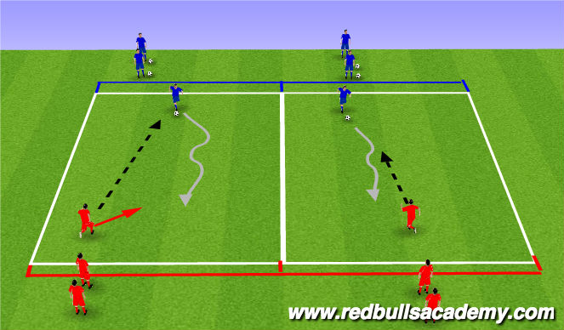
Technique under pressure creates skill….match related

Slide 17
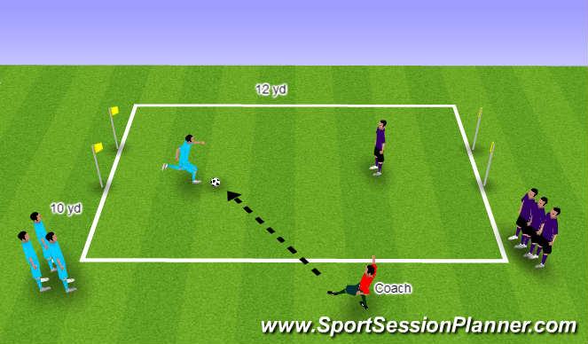
Match Condition….game

Slide 18
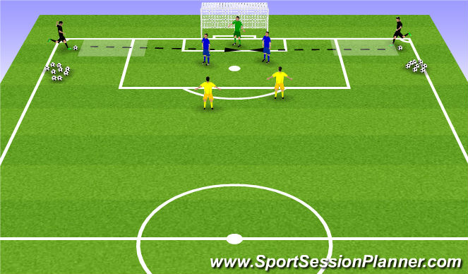
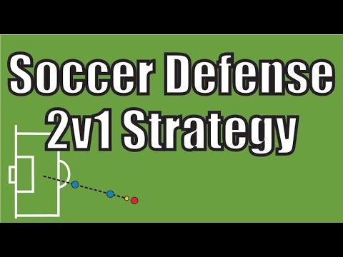
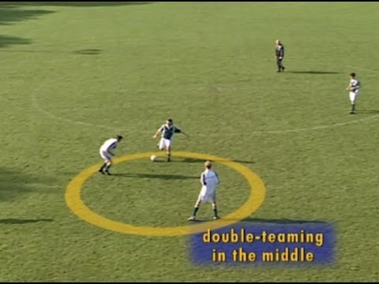
Functional Training….Which part of the field or group?
Functional Training is specific to the positional players…backs, midfielders, forwards, goalkeepers.
Functional session should take place in the specific parts of the fields that the players play.

Slide 19
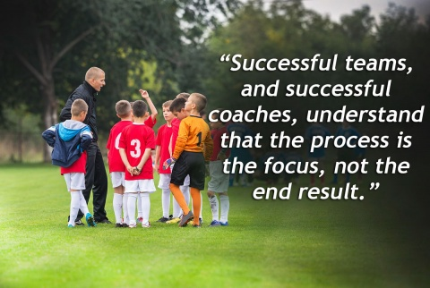

Slide 20
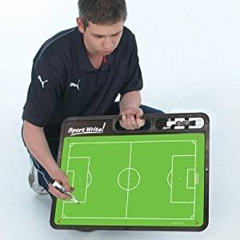
Part II
Anatomy of Coaching the Session
What do we want to accomplish today?
How much time do we have?
How many activities should we need?
Technical, tactical, or functional?
How many players will train?
How much space do we have?
Do we need a goal(s)?

Slide 21

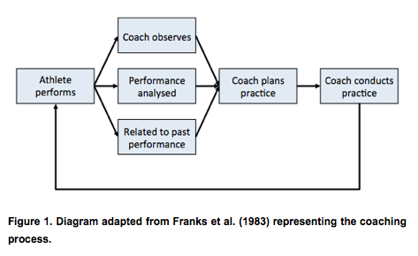
Coaching Cycle

Slide 22
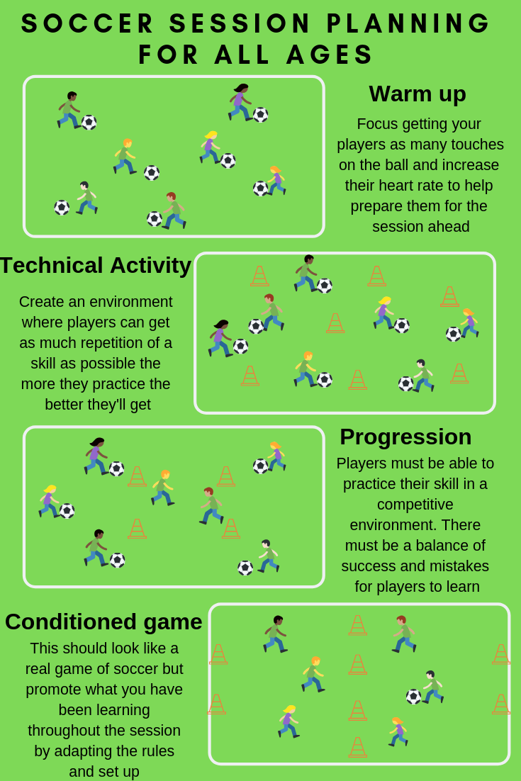
If you fail to prepare, prepare to fail!
Plan out your session in advance
Review your session
Make changes
Is this what they really need today?

Slide 23
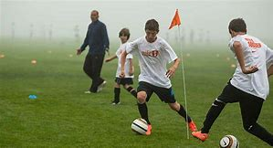
Controlling the Training Environment
Number of players (more, less)
Touches (unlimited, restricted)
Space (larger, smaller-tighter, distance)
Time (seconds, next goal)
Speed (faster, slower)
Balls (additional)

Slide 24
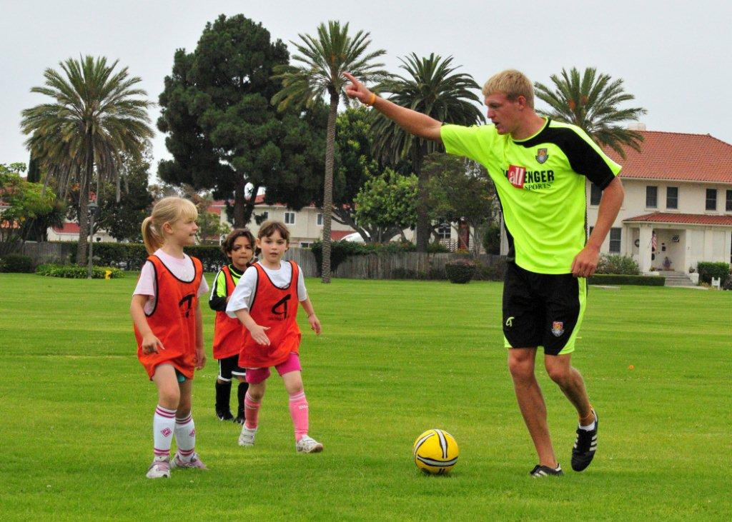
Stopping the exercise…or not!
Will the coaching point help most of the players?
Is this a common issue that needs to be addressed?
Play-freeze-play!
Coaching during play
Reset

Slide 25
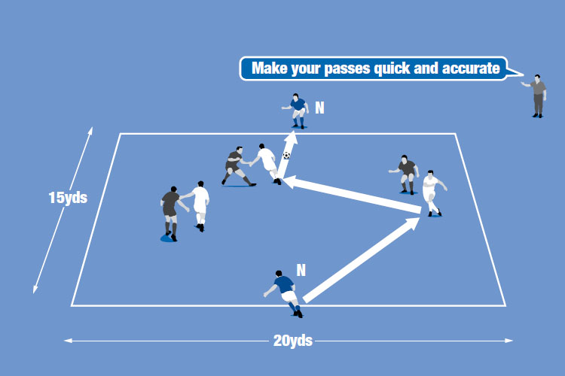
Stopped it…..now what do I say?
Coaching points must be:
direct
specific
timely
effective

Slide 26
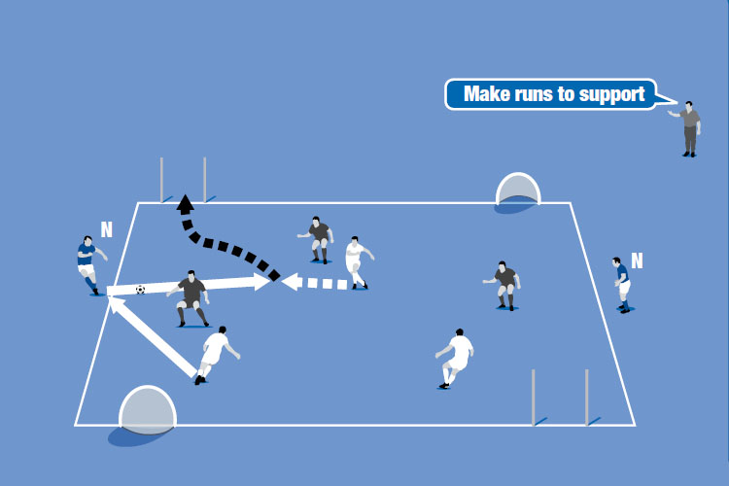
Coaching Points
Do they all understand what you want them to do?
Are you specific enough?

Slide 27
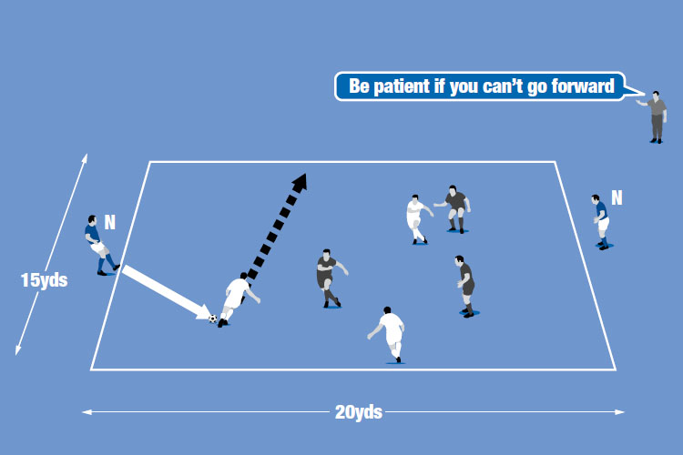
Coaching Points
Did your coaching point change their behavior?
Did it improve their ability to solve the problem(s)?

Slide 28
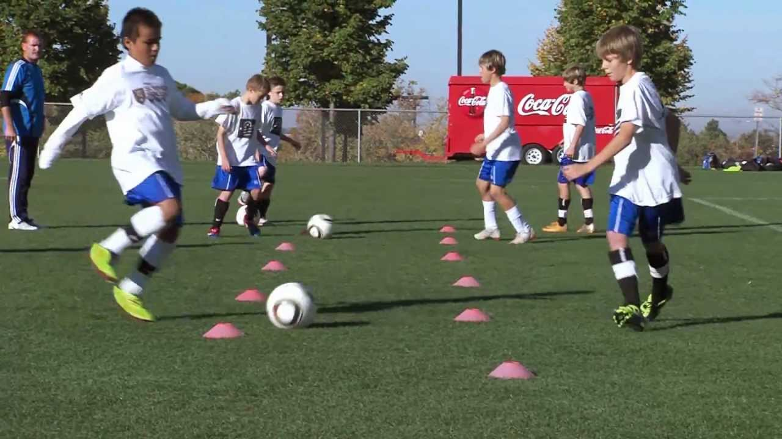
Creating the ideal training environment
Does it look like soccer?
Are they engaged?
Are they all being challenged?
Are they having fun?
Is the objective(s) being met?

Slide 29
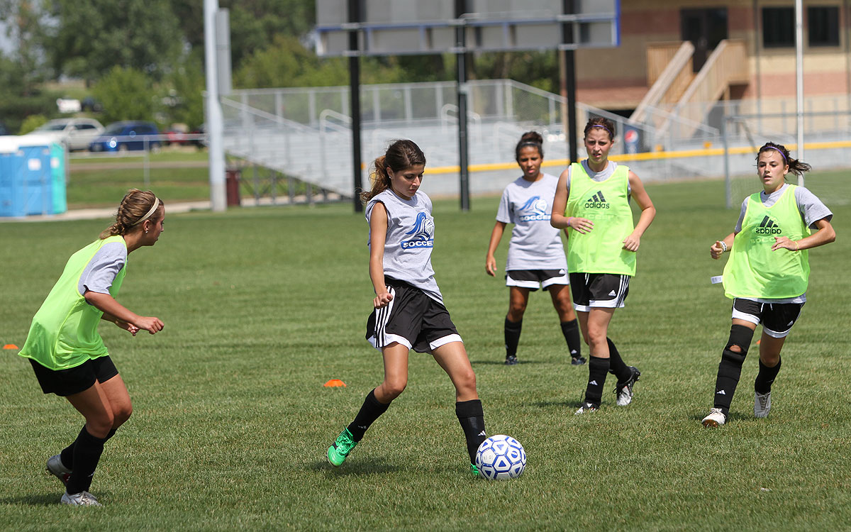
Let them struggle!
Failure is fertilizer
Do not try to control everything that they do
The game is the greatest teacher
Encourage them to figure things out on their own

Slide 30
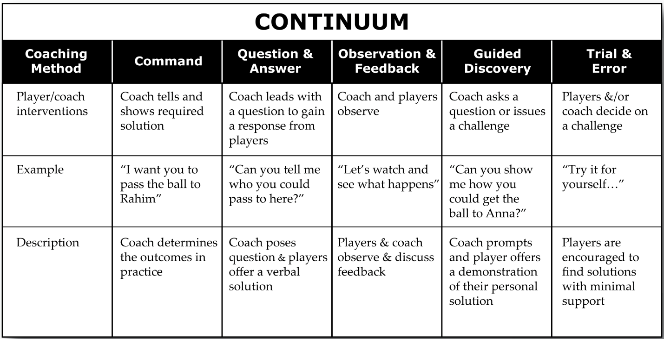

Slide 31
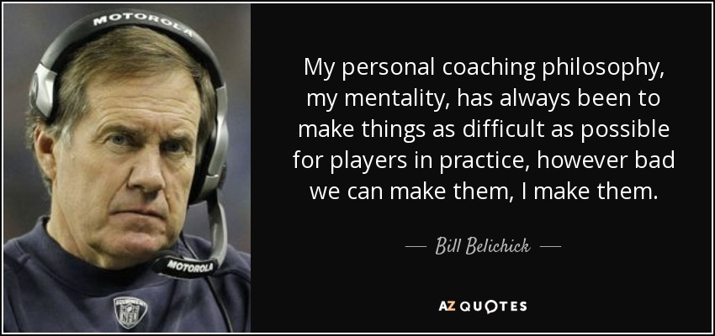

Slide 32
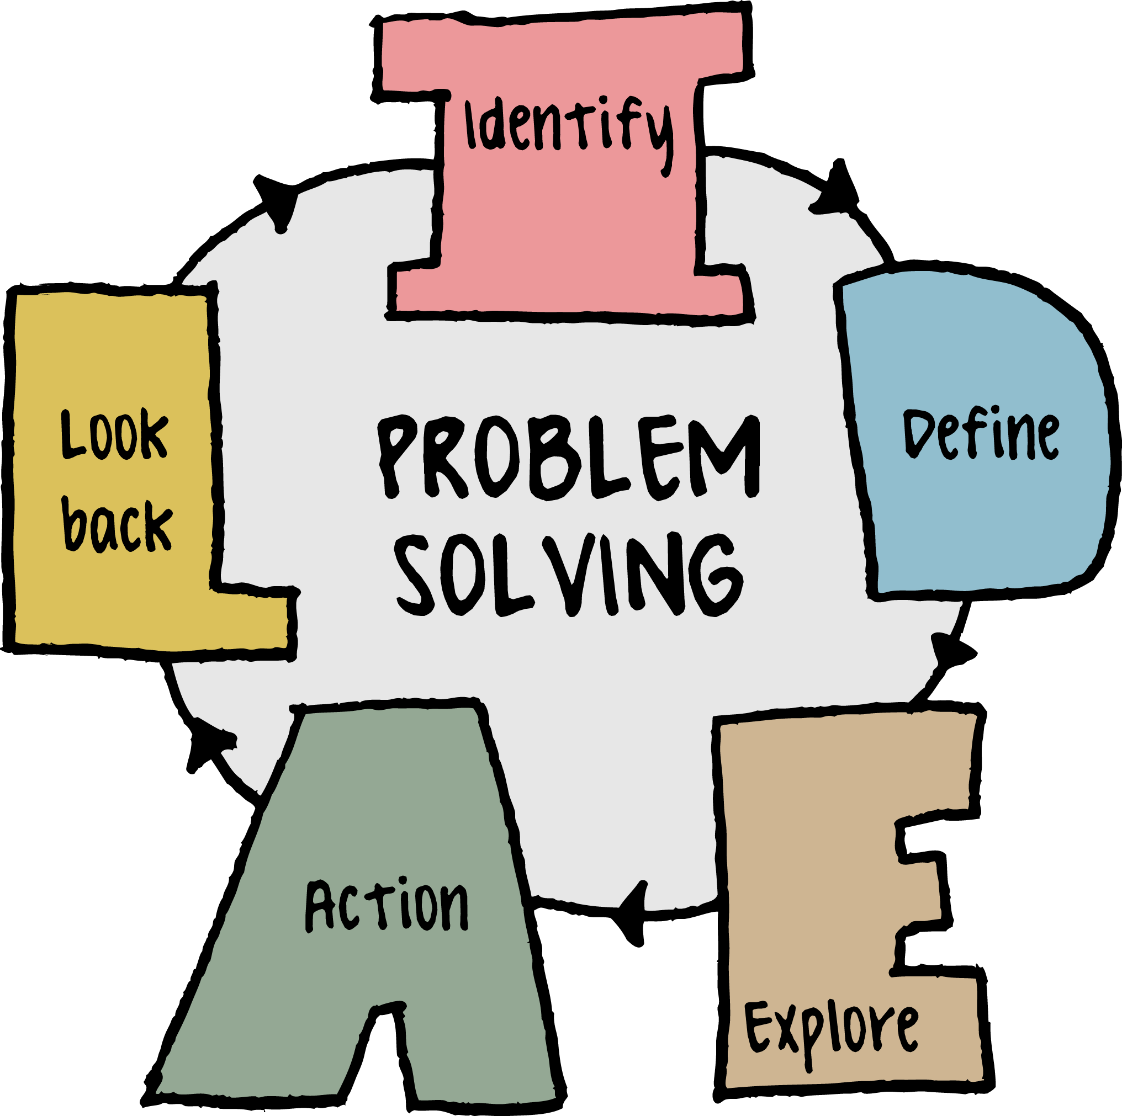
Part III
Fixing the problem(s)

Slide 33
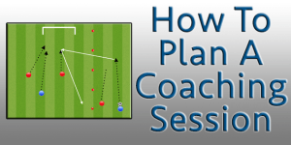
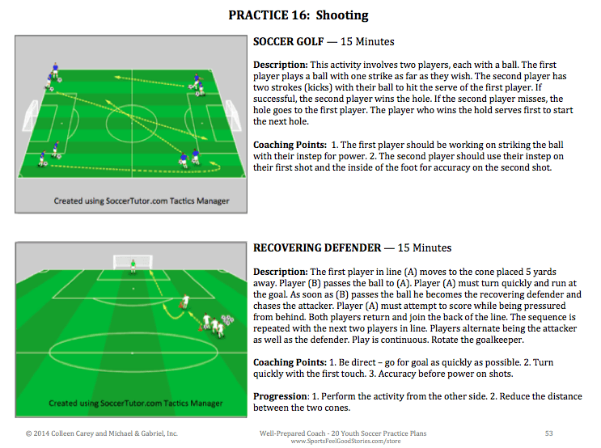
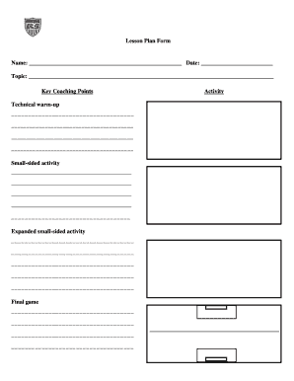
Planning the session

Slide 34
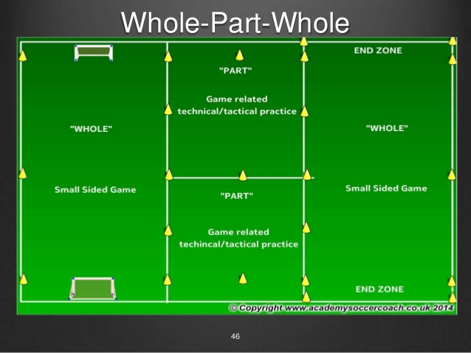
Which method do I need?

Slide 35

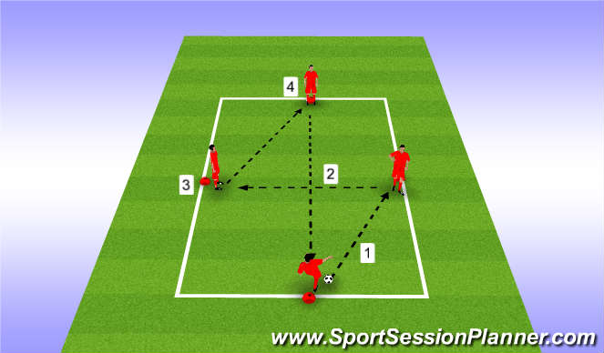
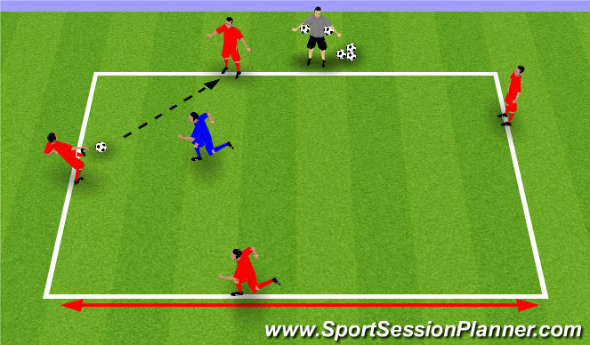
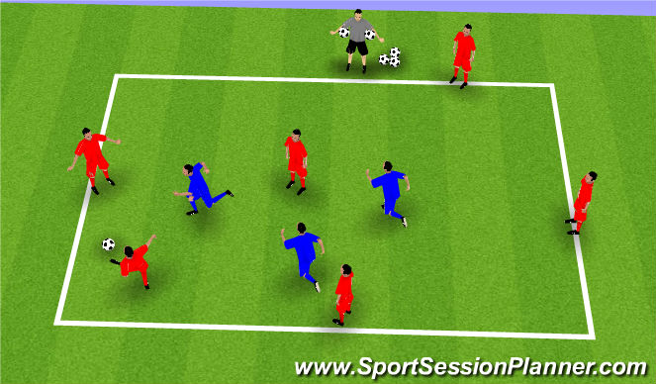
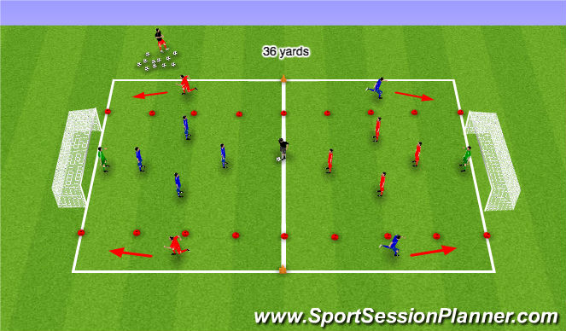
Which method should I use?

Slide 36
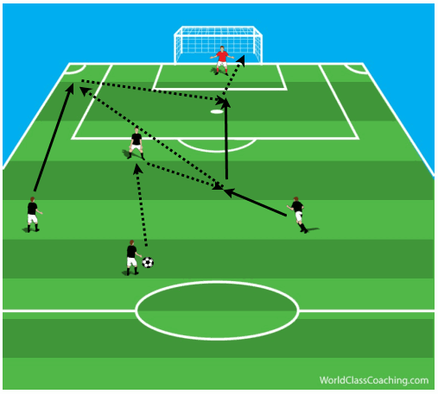
Key Factors:
Technical: Which exercises will change the individual behavior efficiently?
Tactical: Are they reading and reacting to the cues of the game with their partners?
Functional: Can they solve the problem as a group? Which part of the field needs my attention?

Slide 37
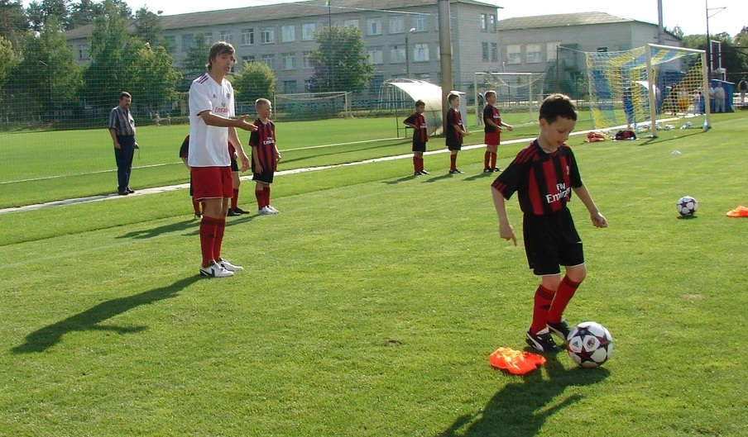
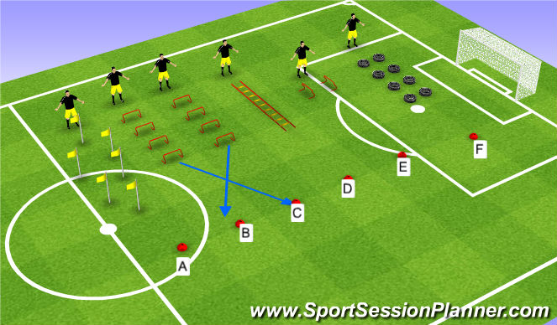
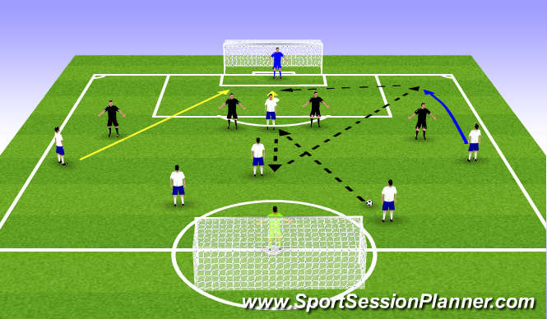
Training Do’s
Make the exercises challenging
Make the exercises player/ability appropriate
Make the exercises realistic
Make the session efficient….set up ahead of time (flow)
Make the session look like the game
Make sure that they are all engaged
Focus the session on just one (or two) areas

Slide 38
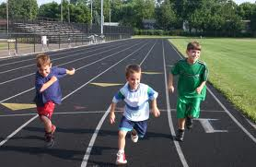
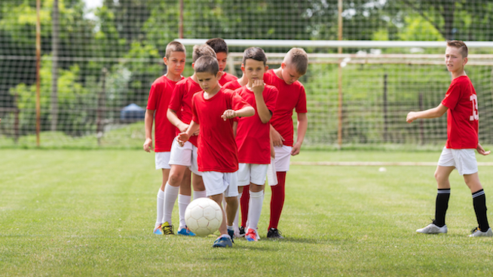
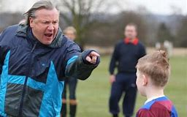
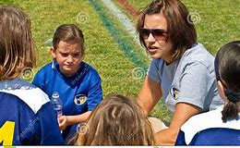
Training Don’ts
Laps
Lines
Language
Lectures

Slide 39

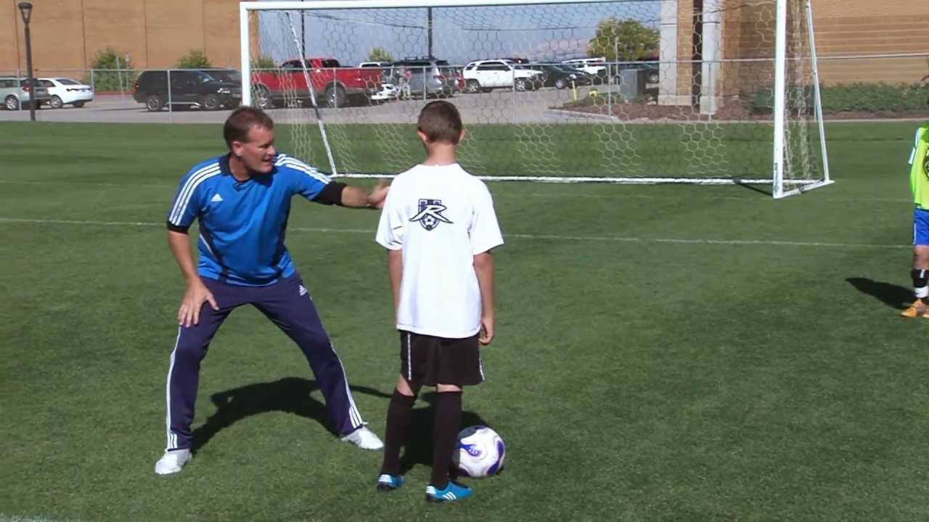

During the activity….COACH
Make the coaching points brief
Catch them doing it right
Coach individual players as well as the team
Connect with as many individual players as possible
Check for players that are struggling

Slide 40


After the session with the team
Review the topic
Check for understanding
Reiterate the “key concepts”
Offer a challenge

Slide 41

After the session…reflect!
How was the session?
Did they “get it”?
Was this what you wanted them to learn/do?
What could you have done better/changed?
Do you need to repeat this session/activities?

Slide 42



Slide 43


Part IV
Formations, Styles, Shape, and Rhythm of Play
Players determine the style of play (direct or indirect).
Coaches determine the formation based on players abilities (4-4-2, 4-3-3, 4-5-1).
The match dictates the “in-game” adjustment to system and style of play.

Slide 44

Players roles defined
What do you want from your backs?
How do you want your midfielders to attack/defend?
Are you playing with a target player up front?
Do you play back to your goalkeeper?

Slide 45


Adjusting Styles and Formations
Do your players abilities match your desired style?
Are you using the best formation for your team’s success?
Can your players establish a rhythm (pace) of play?
Does the game situation require an adjustment of style, formation, or both?

Slide 46


Team Shape
Organize shape in the 3 thirds of the field.
Shape with the ball and shape without it.
Your shape will allow you to play in the desired style and help to create a rhythm.
Is your shape allowing you to keep the ball?
Can you play through the 3 thirds of the field?

Slide 47


Possession
Keep numbers close to the ball to maintain possession.
Use shape to provide vertical and horizontal support.
The style of play will help to dictate the rhythm of the team.
Vary the shape and rhythm in each of the 3rds of the field.
Does your possession have a purpose?

Slide 48




Formations: 4-4-2, 4-3-3, 4-5-1

Slide 49


Formations
Dictated by your players abilities and personalities. Speed, technical, vision…etc.
You are not BARCELONA!!
Must be realistic…can they execute?
Complimentary v. adversarial….chemistry.
Are you getting the maximum abilities of your players out of this formation?
Dictated by the match situation as well.

Slide 50

Transition…offense to defense and vice versa.
How do your players react when they lose the ball?
How do your players react when they win the ball?
Do they know where and when to recover?
Are they organized? How is their shape?
On attack use speed to your advantage…play direct where possible.
On defense, slow them down and allow for numbers to get behind the ball….put immediate pressure on the ball.

Slide 51



Conditioning
Can they use a ball?
What is the specific purpose…speed, agility, quickness?
Can this be done separate to the training time allotted?
Make sure that they are peaking as the season progresses.
Do not use conditioning as punishment.
Can you make it competitive, fun?

Slide 52



Recovery Training
Strictly fun activities day.
Vary the training intensity.
Team bonding activities.
Challenging activities that are not soccer specific.
Soccer tennis or handball can be a great way to cool down after practice or on a recovery day.

